Slide 1
Background knowledge
Attention
Charities?

Slide 2
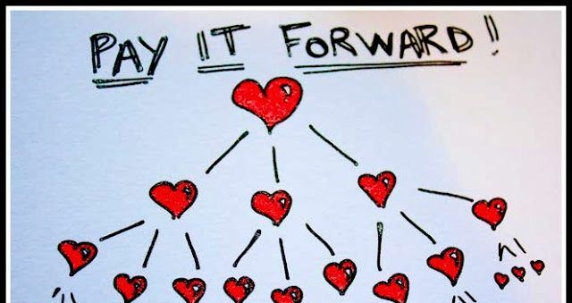
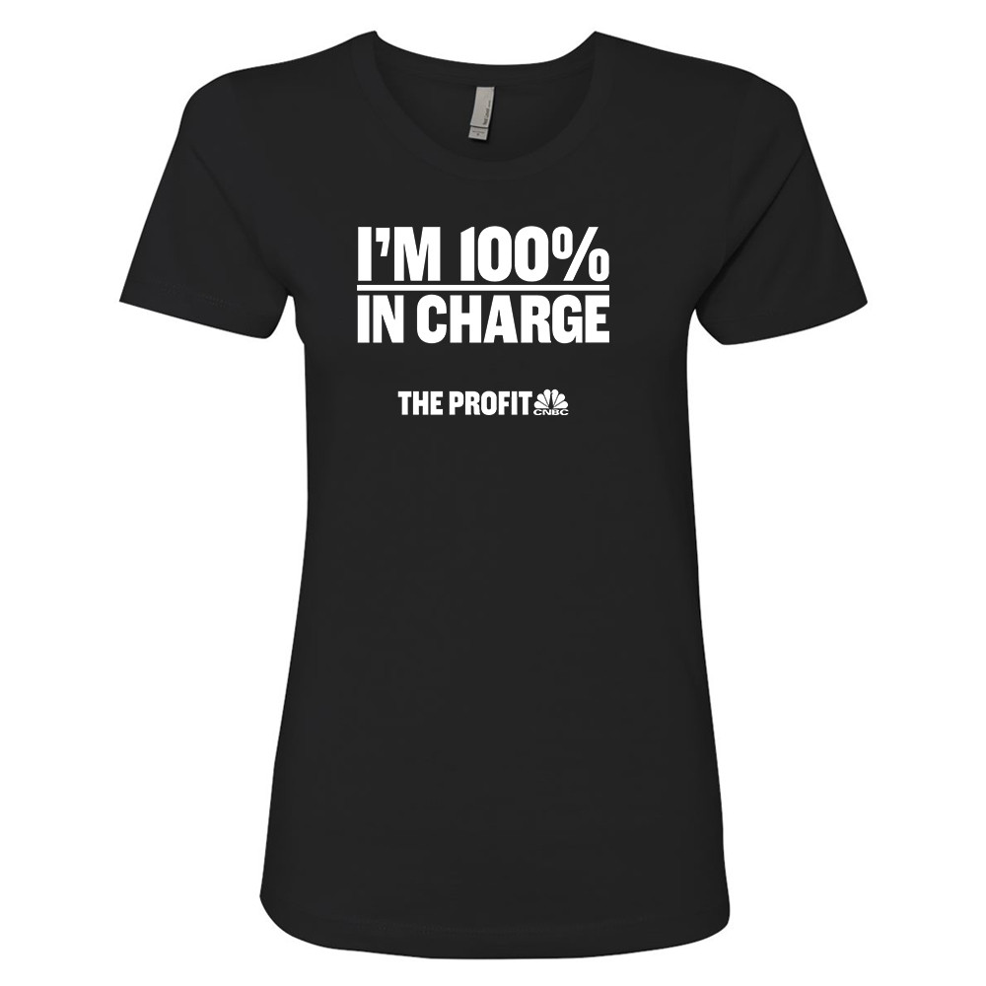
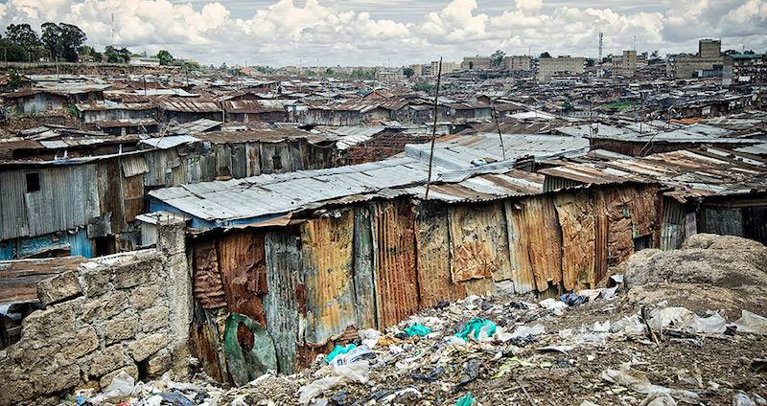
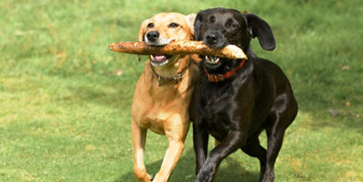
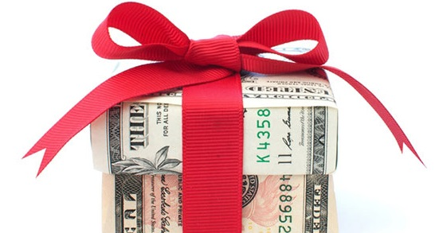
Warm Up
Charity?
Christopher Bauman – www.chrisbauman.com.au

Slide 3
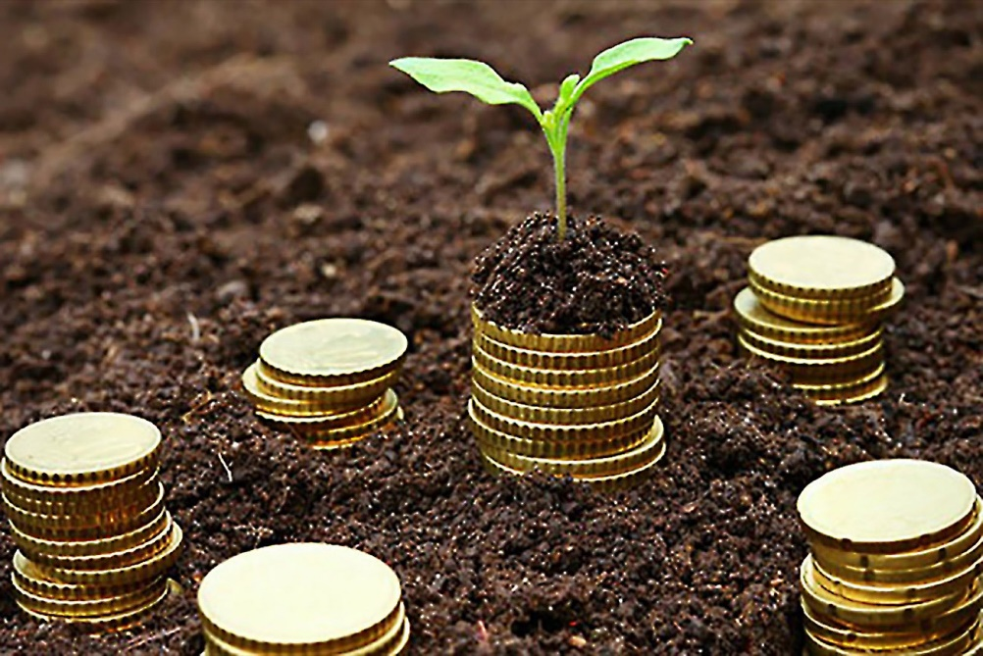
Warm Up
Listening
Developing countries
Share?
What are you in charge of
Responsible citizen
How can you change the world
Spare pennies
philanthropic networks
Paying forward
Seed money
Gift, donation
Capacity to expand
Source of income
Pride
Microfinancing (tiny loans provided)
Christopher Bauman – www.chrisbauman.com.au

Slide 4
Responsibility
1. Are there any words in the wordbank that you don’t understand?
2. Share
3. Spot check

Slide 5
Listen to understand
Explain to your friend (English)
Paraphrase

Slide 6
Read a paragraph and write down 1 question
Yes / No (X)
Ask your friend
Teach your friend

Slide 7
Share one thing you learned

Slide 8
Starting your own Charity
Are there any successful charities in Taiwan?
What are some (unmet) needs in Taiwan?
What would you call your charity?
What are three things you could do?

